Slide 1
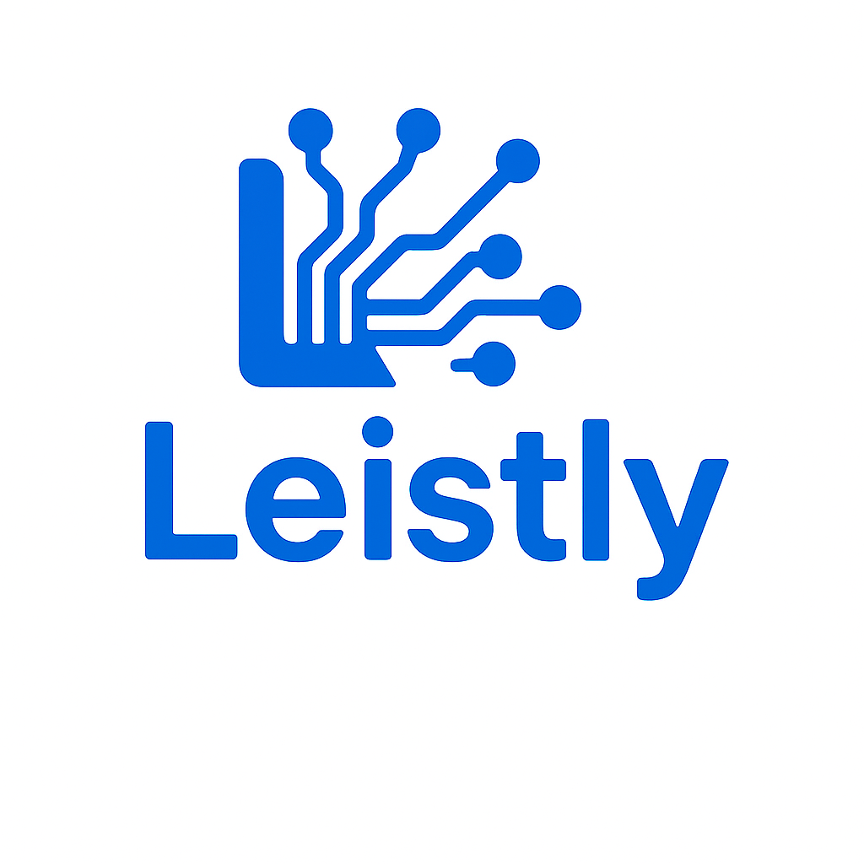
Where AI Enhances Human Capabilities

Slide 2



The Founder – Thomas Francis
5
8
5
Moved to Burlington during COVID in 2020 | Close to 2 decades of experience in the IT industry.
Lives with wife and 3 daughters in Alton Village Burlington | 6 years in Product development and 12 years in Consulting
Why Leistly?
“I believe Small and Medium businesses (SMB) are the biggest benefactors of the AI disruption. While there is a lot happening in the AI market the biggest GAP I see are trusted advisors who partners with SMB to guide them and explore the art of the possible using AI, Leistly aspires to bridge that GAP.”

Slide 3
The Company – Leistly
Vision: To redefine front-office operations with intelligent, user-friendly systems that deliver deeply personalized and frictionless customer experiences.
Value Proposition: We are your trusted partner in the fast-paced AI landscape—empowering you to make informed adoption decisions that minimize risk and maximize opportunity.
Headquartered: Burlington, ON | Founded: 2025
Contact: +-416-879-1731 | Email: contact@leistly.com

Slide 4

Patient Interaction Stats
Dental offices miss 25-35% of calls during off hours causing $150,000-$200,000 losses annually due to missed opportunity.
Be the first mover – Only 3.4% of dentists currently use voice AI software.
80% of the adopters agree AI voice bots improve patient experience and front office efficient by 40%.
Health care institutions using voice bots reduce admin costs by 76%
Adoption of AI voice bots can reduce front office administrative staff by approximately 20% to 40%

Slide 5
GVBot
Appointment Management | Available | Fee
Schedule New | ✓ | $
Reschedule Existing | ✓ | $
Cancel | ✓ | $
Email validation |  | -
Phone validation(Whatsapp+SMS) |  | -
Appointment Reminder (24 hrs) to Customer (Call/SMS) |  | -
Reminder to leave (if address provided 1 hr) (Call/SMS) |  | -
Appointment Reminder (5 mins) to Dentist (Service Technician) - SMS |  | -
Patient Management
Use PMS calendar to manage appointment |  | $
Use PMS patient identifier for existing patients |  | $
Insurance claim through existing PMS integrations |  | $
Re-use any details of the PMS software to personalize interaction |  | $
Customer Service | Available | Fee
Location and other contact information | ✓ | $
Details about services offered in the clinic | ✓ | $
Details of the doctor and his experience | ✓ | $
Customer Survey and Feedback Post Appointment |  | -
Other Digital presence
Website with a chat offering similar service to the voice bot |  | $
Clinic tablet with payment option |  | $
Clinic tablet to gather insurance details |  | $
Marketing + Lead Generation
Outbound calls to potential patients who leave their number/email on website |  | -
Notes:
Inspired by Greene Vardiman Black – Revolutionized dental education and techniques; often called the Father of Operative Dentistry.

Slide 6
Pilot – Key Metrics and Success Criteria
Key metrics that will be measured
Call Volume – Total number of calls handled by the bot.
Call Completion Rate – Percentage of calls that successfully result in an appointment or resolution.
Drop-off Rate – Percentage of users who abandon the call before completion.
Average Call Duration – Time spent per call, indicating efficiency or complexity.
User Engagement Rate – How actively users interact with the bot
Appointment Booking Rate – Percentage of calls that result in a confirmed appointment.
Reschedule Rate – Frequency of users changing their appointments.
Cancellation Rate – Percentage of booked appointments that are later canceled.
Transfer Rate to Human Agent – Percentage of calls escalated to a live agent.
Response Latency – Time taken by the bot to respond to user input.
Call to Action
We are looking for 1 clinic to sign up for our free pilot
Play around with our bot : +1-249-528-0550
For all the paid features estimate is around *$200/month
*- Final price may vary post pilot

Slide 7
Email : contact@leistly.com
Phone: +1-416-879-1731
Try our bot at : +1-249-528-0550

Slide 8
Vision and Value Proposition
Vision: To redefine front-office operations with intelligent, user-friendly systems that deliver deeply personalized and frictionless customer experiences.
Value Proposition: We are your trusted partner in the fast-paced AI landscape—empowering you to make informed adoption decisions that minimize risk and maximize opportunity.

Slide 9
Problem Statement
Vision: To redefine front-office operations with intelligent, user-friendly systems that deliver deeply personalized and frictionless customer experiences.

Slide 10
Target Addressable Market - Opportunity

Slide 11
Solution Overview

Slide 12
Marketing and Sales Strategy

Slide 13
Competitive Analysis

Slide 14
Roadmap

